Slide 1

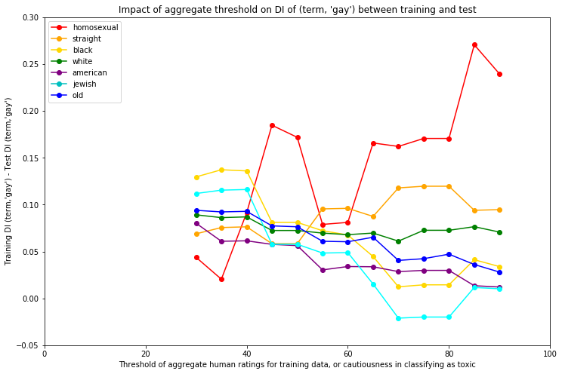
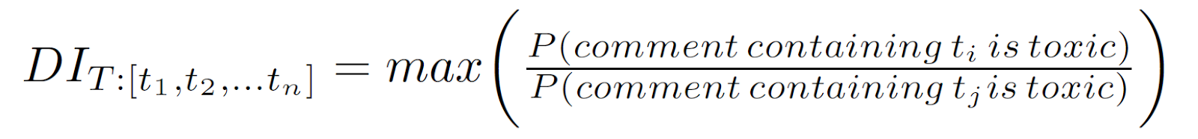
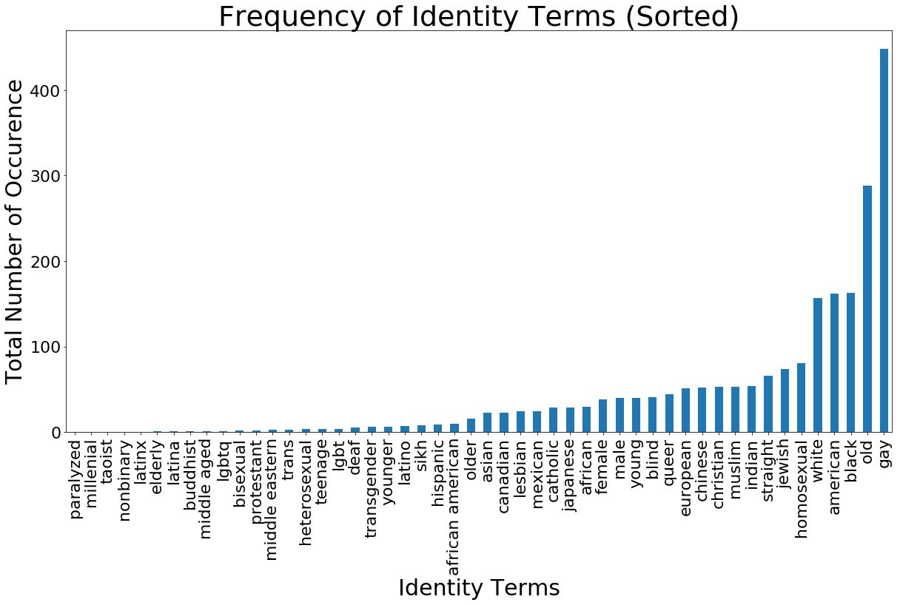

WHEN THE TRUTH IS NOT TRUE
A Study of Perturbations on “True” Toxicity in Text Classification
Neha Gupta, Yujing Ke, Neil Pruthi, Brandon Fain, Ashwin Machanavajjhala
Motivation
Posting comments is easy, yet ensuring the content being “healthy” can be difficult. The threat of negative online behavior can drive away users and cause loss to the website. Therefore, a website may want to deploy a classifier to automatically flag comments that are mean, hateful, prejudiced, offense, or some combination thereof. However, a classifier may exhibit bias and lead to unfairness because it may predict, correctly or incorrectly, a toxic label for comments about a particular demographic group more often than comments about other demographic groups. In this project, we are interested in the question about how different levels of dataset bias affect the bias of a classifier trained on that dataset. We will tackle this question by perturbing the dataset in a variety of ways and observing the resulting changes in fairness of classified data.
Methods (continued)
Random Variations in Toxicity of Training Data
To introduce noise into the training data, we randomly select some p% of comments, and for those comments, we assign a random toxicity value of either [0,1].
Our metric for biased data is based on a generalized disparate impact for a large number of identities. Intuitively, a high disparate impact value means comments containing term t₁ are more likely to be labeled as toxic than comments containing a term t₂. We compute disparate impact for all pairs of terms and compute our disparate impact as:
Figure 2 looks at DI values for the test data compared to predicted values computed on training data.
Variation in Cautiousness of Toxicity Definition
The original crowdsourced dataset given by [cite] is broken down by human rater, where at least 10 human raters provided a binary rating for each comment. [cite] checks for a mean binary rating across raters greater than 0.5 to classify the comment as toxic in the training dataset. We adjust this threshold and observe changes in the disparate impact when comparing each demographic identity term to the term ‘gay’, shown in Figure 3.
Conclusion
Mauris orci mi, varius id diam id, egestas auctor enim. Praesent ut massa nibh. Duis purus neque, facilisis cursus ultrices vel, ullamcorper ac augue. Donec semper lorem:
Sed Risus Nibh: CiIn nisl quam, aliquet sed nibh sitamet, faucibus placerat dui augue scelerisque.
Curabitur Accumsan Nulla: Fusce quis augue urna scelerisque, luctus rum sed, ut dolor in pulvinar in eros.
Elementum Orci Dignissim: Proin semper ipsum finibus quam tempor, vitae consectetur.
Methods
Our data is split into a training dataset containing approximately 96,000 comments, and a test dataset containing approximately 32,000 comments. We used a logistic regression classifier to predict a binary value for toxicity on the test dataset.
In order to ensure we have sufficient sample sizes for each identity term, we only show results for demographic identity terms that appear in at least 3% of comments with identity terms. Figure 1 shows the identity terms, in set T, that met our threshold.
Results
Mauris orci mi, varius id diam id, egestas auctor enim. Praesent ut massa nibh. Duis purus neque, facilisis cursus ultrices vel, ullamcorper ac augue [See Figure A]. Done:
Sed in risus nibh. In nisl quam, aliquet sed nibh sitamet, faucibus placerat dui.
Fusce quis augue scelerisque, luctus rum sed, ut dolor. pulvinar urna in eros posuere.
in elementum orci dignissim. Proin semper ipsum
References
Dixon, Lucas, et al. "Measuring and mitigating unintended bias in text classification." available at: www.aies-conference. com/wp-content/papers/main/AIES_2018_paper_9. pdf (accessed 6 August 2018).[Google Scholar]. 2018.
Wulczyn, Ellery, Nithum Thain, and Lucas Dixon. "Ex machina: Personal attacks seen at scale." Proceedings of the 26th International Conference on World Wide Web. International World Wide Web Conferences Steering Committee, 2017.
Rudinger, Rachel, Chandler May, and Benjamin Van Durme. "Social bias in elicited natural language inferences." Proceedings of the First ACL Workshop on Ethics in Natural Language Processing. 2017.
Bolukbasi, Tolga, et al. "Man is to computer programmer as woman is to homemaker? debiasing word embeddings." Advances in Neural Information Processing Systems. 2016.
Hardt, Moritz, Eric Price, and Nati Srebro. "Equality of opportunity in supervised learning." Advances in neural information processing systems. 2016.
Kusner, Matt J et al. “Counterfactual Fairness.” available at http://papers.nips.cc/paper/6995-counterfactual-fairness.pdf (accessed 26 Nov 2018). 2018
Department of Computer Science Duke University
cs.duke.edu
Mauris orci mi, varius id diam id, egestas auctor enim.

